Slide 1



TexPoint fonts used in EMF.
Read the TexPoint manual before you delete this box.:

Slide 2



Slide 3

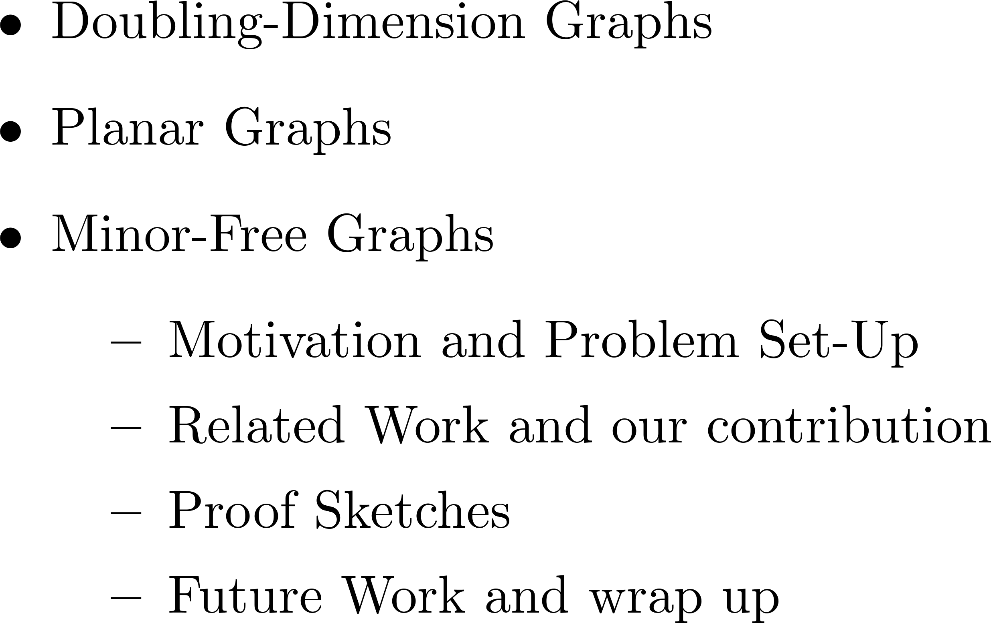

Slide 4



Slide 6
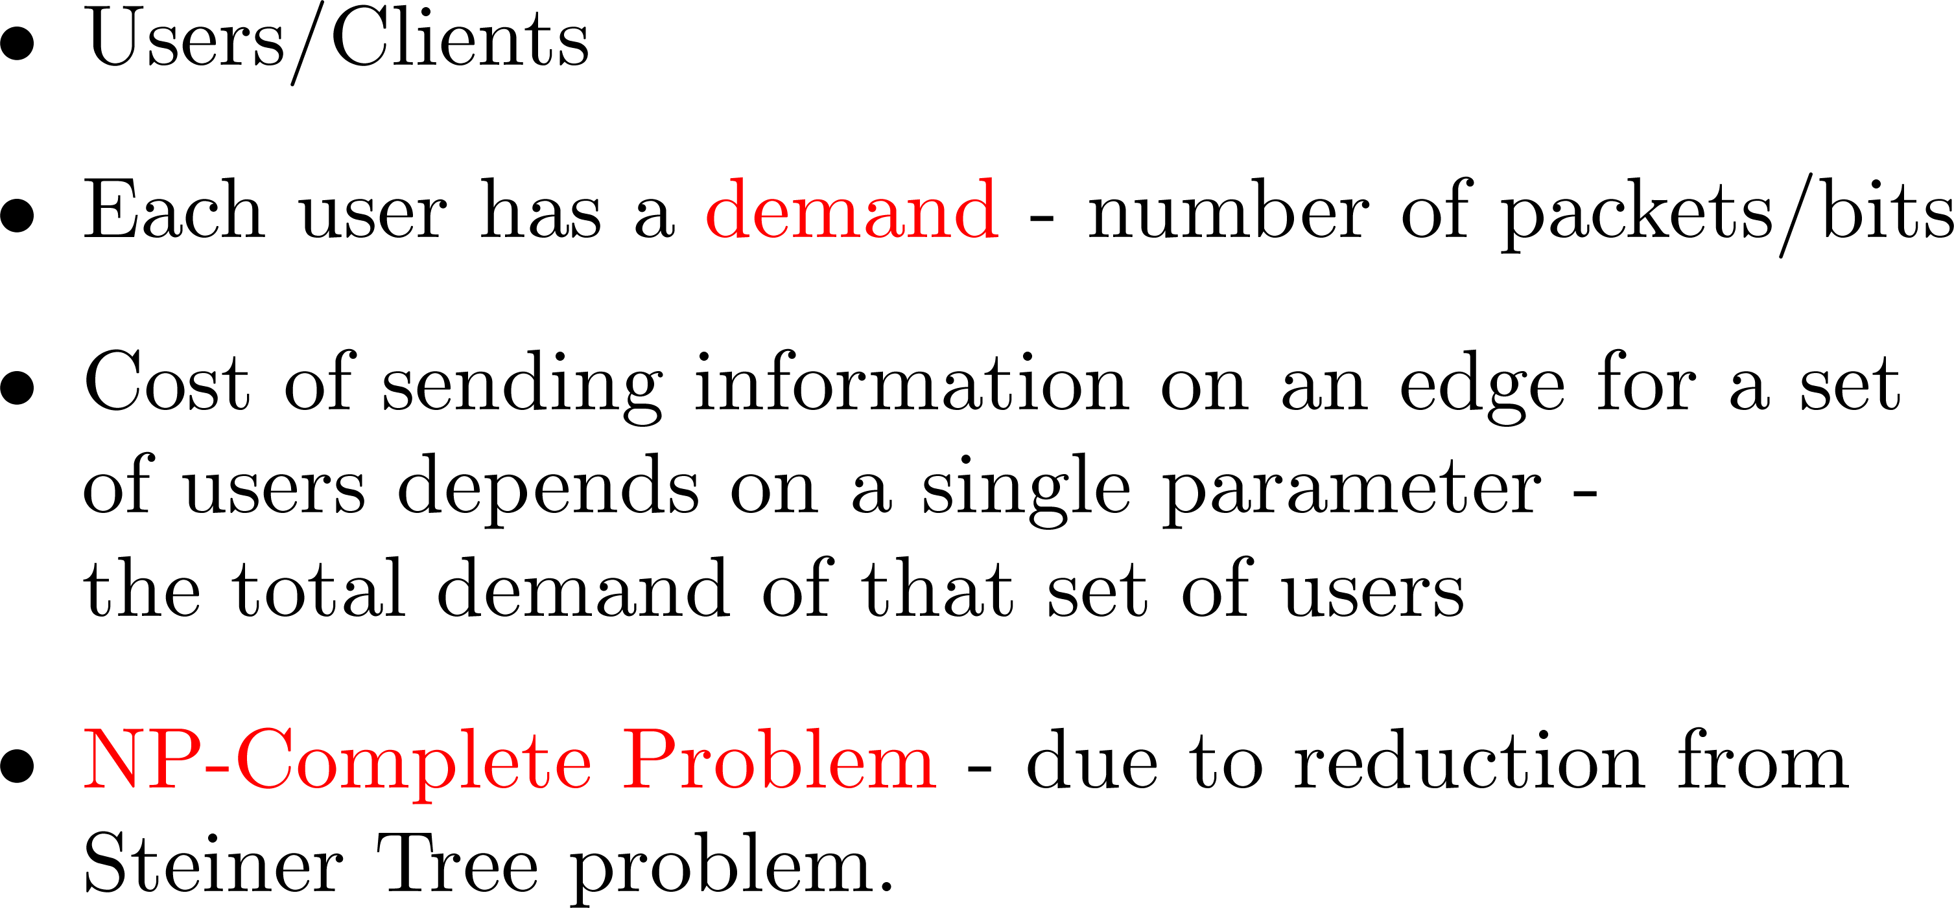

Slide 7





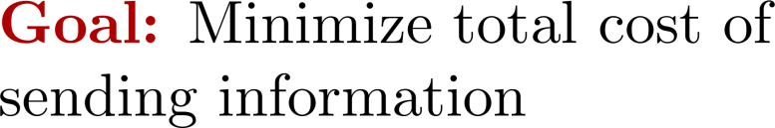
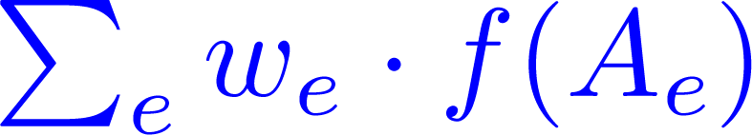
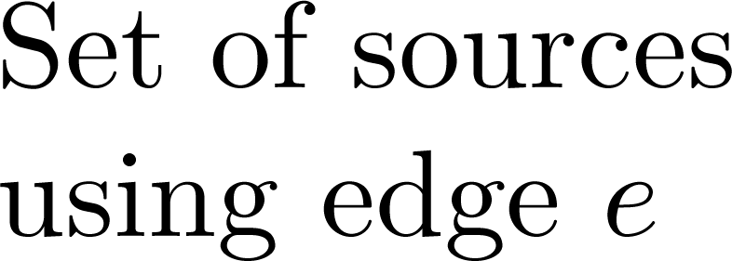


Slide 9


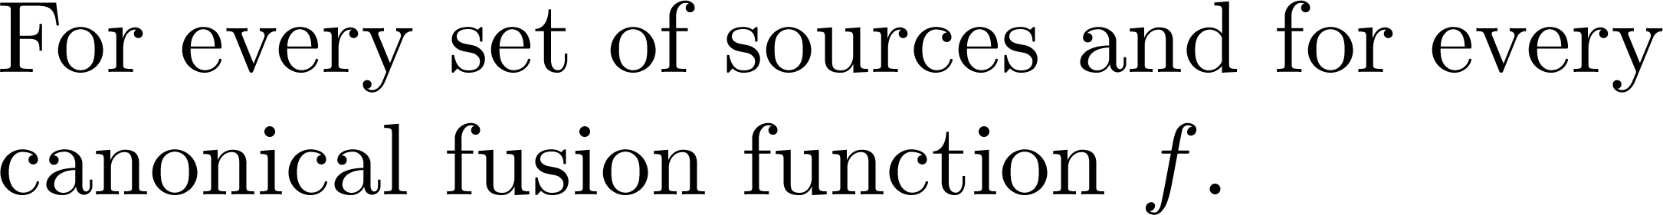



Slide 10
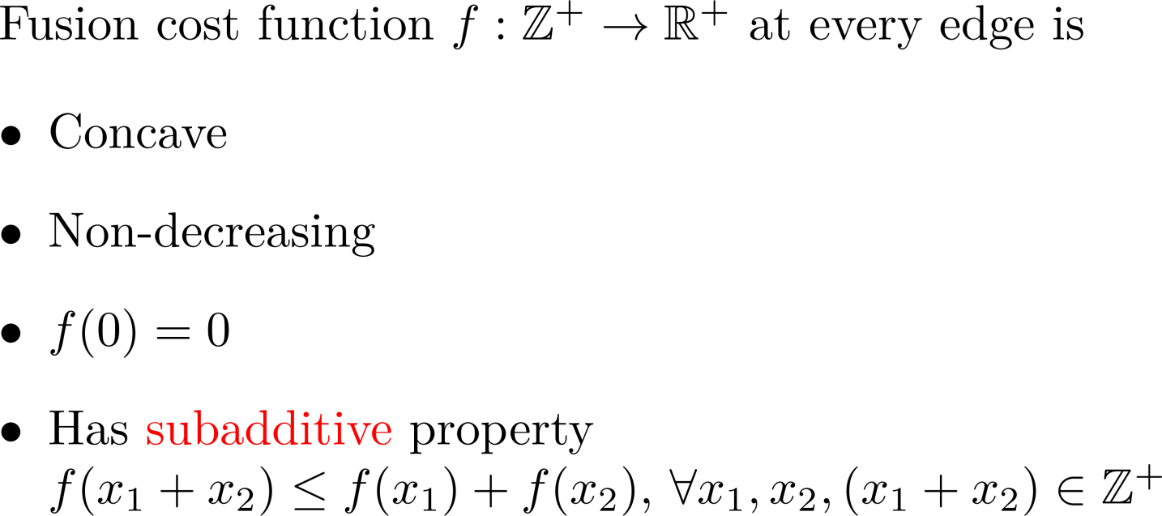



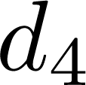
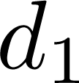
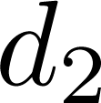
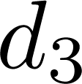





Slide 11


Slide 12

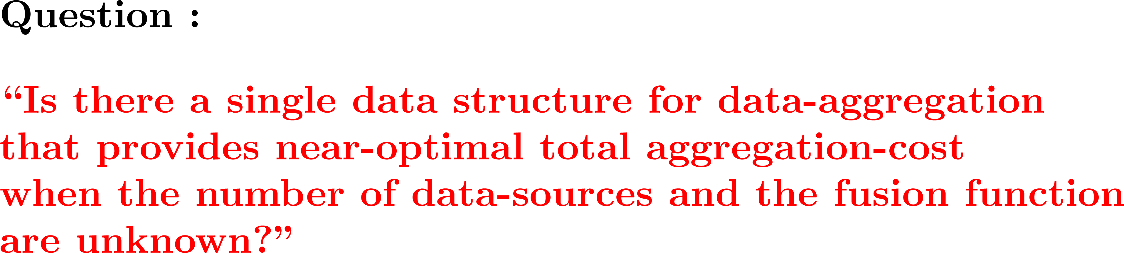

Slide 13


Slide 14


Slide 15
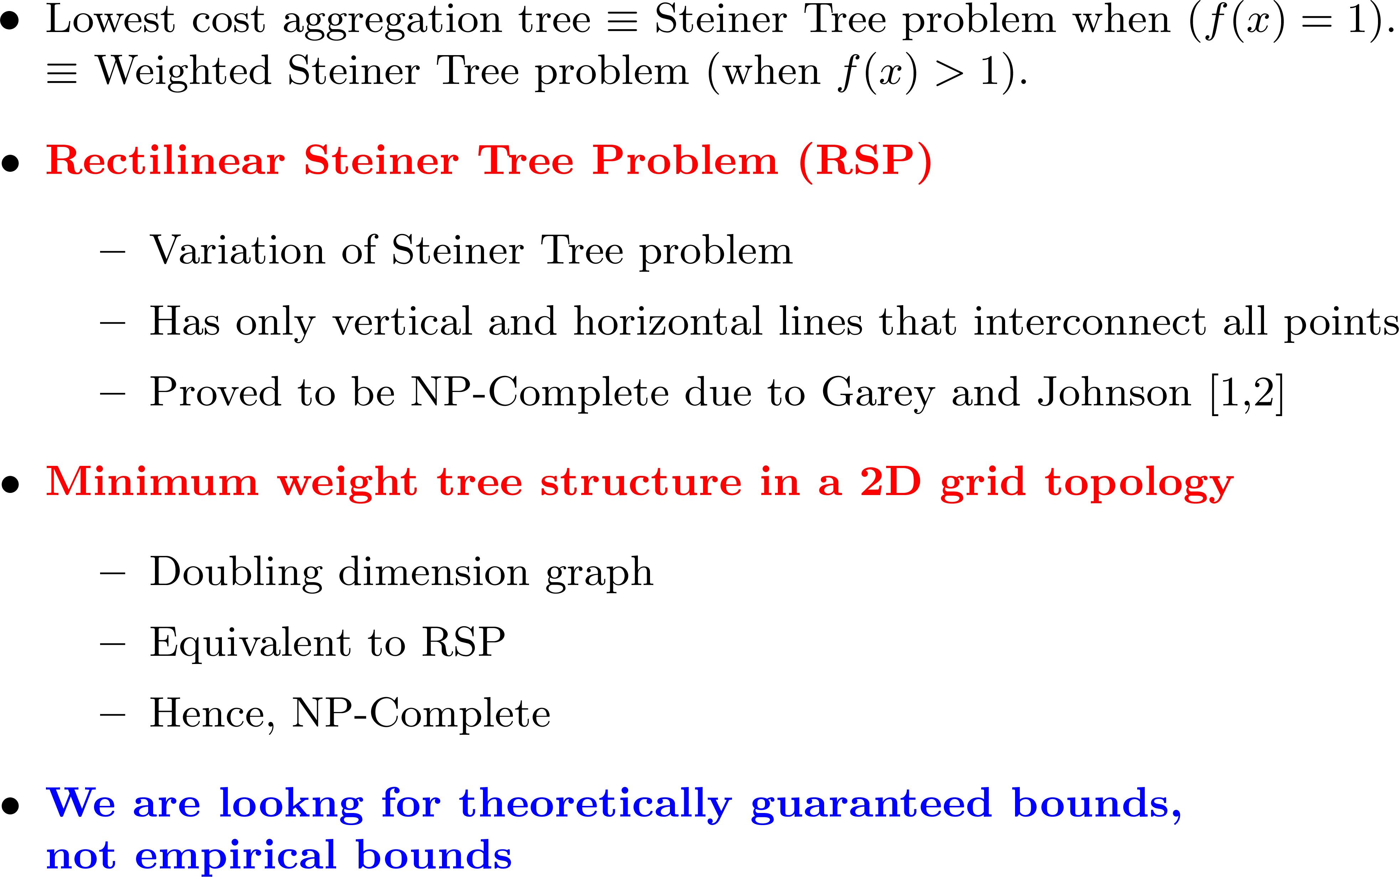
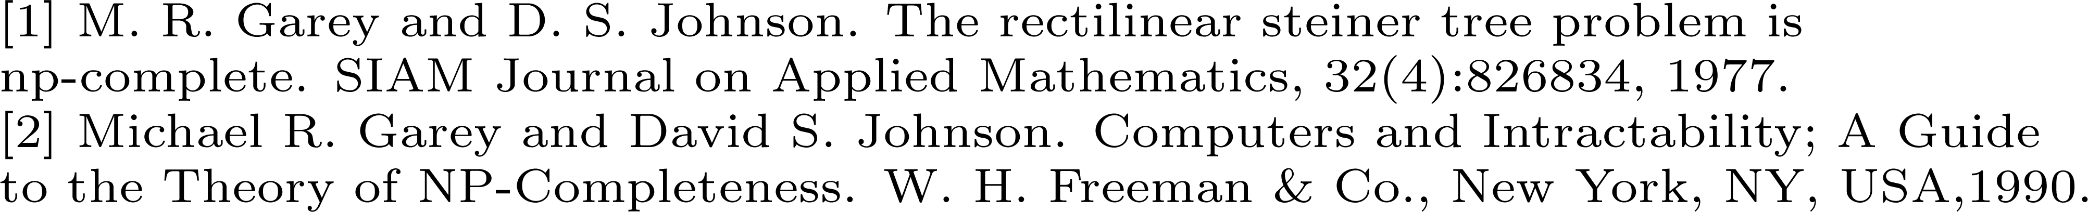

Slide 16
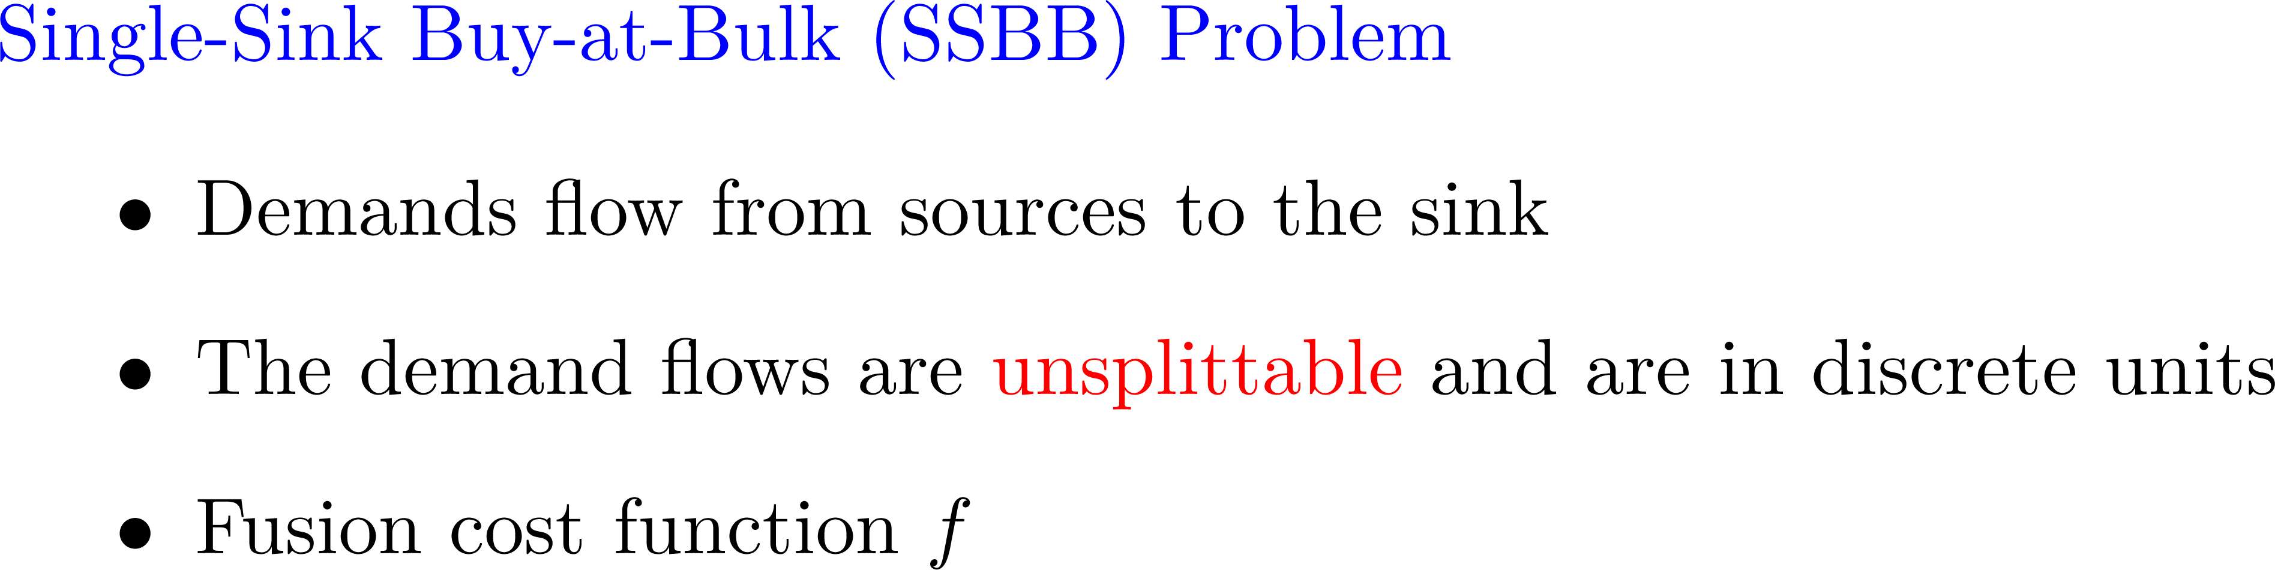

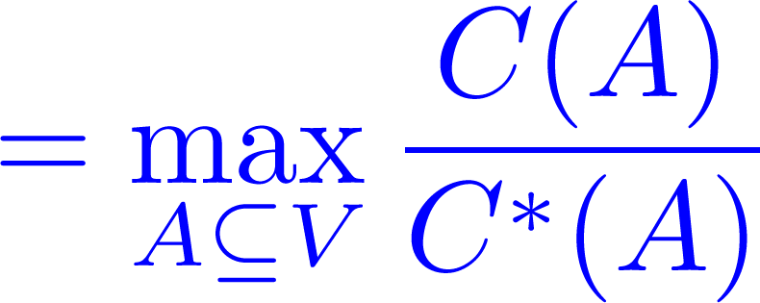

Slide 17

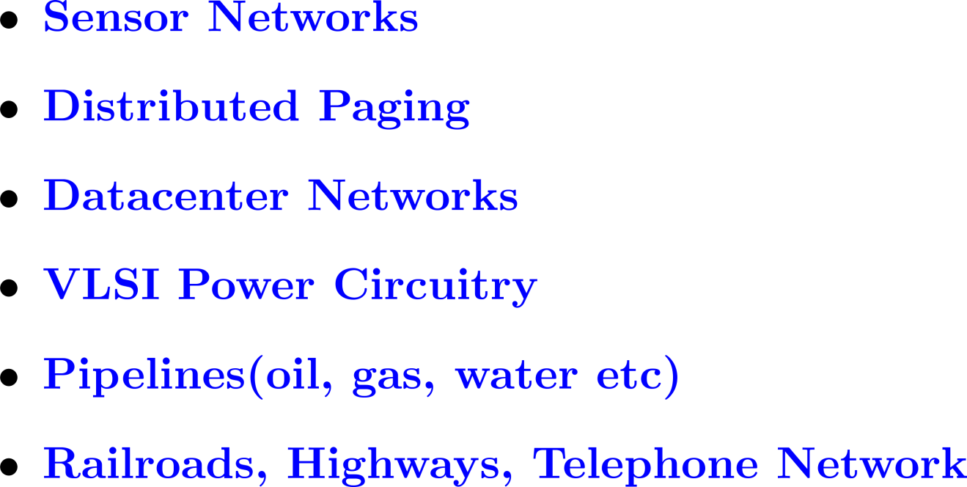

Slide 18

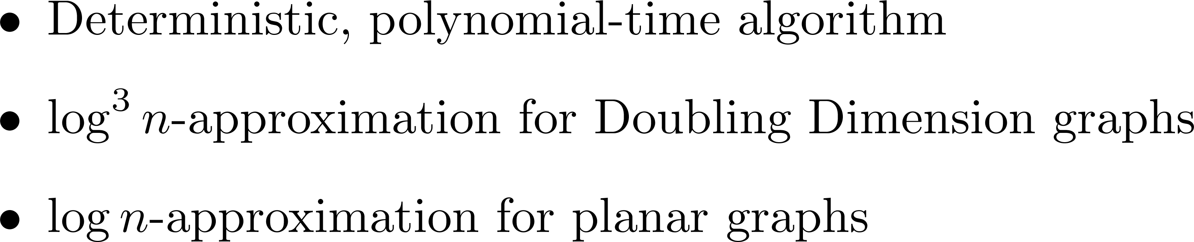

Slide 19

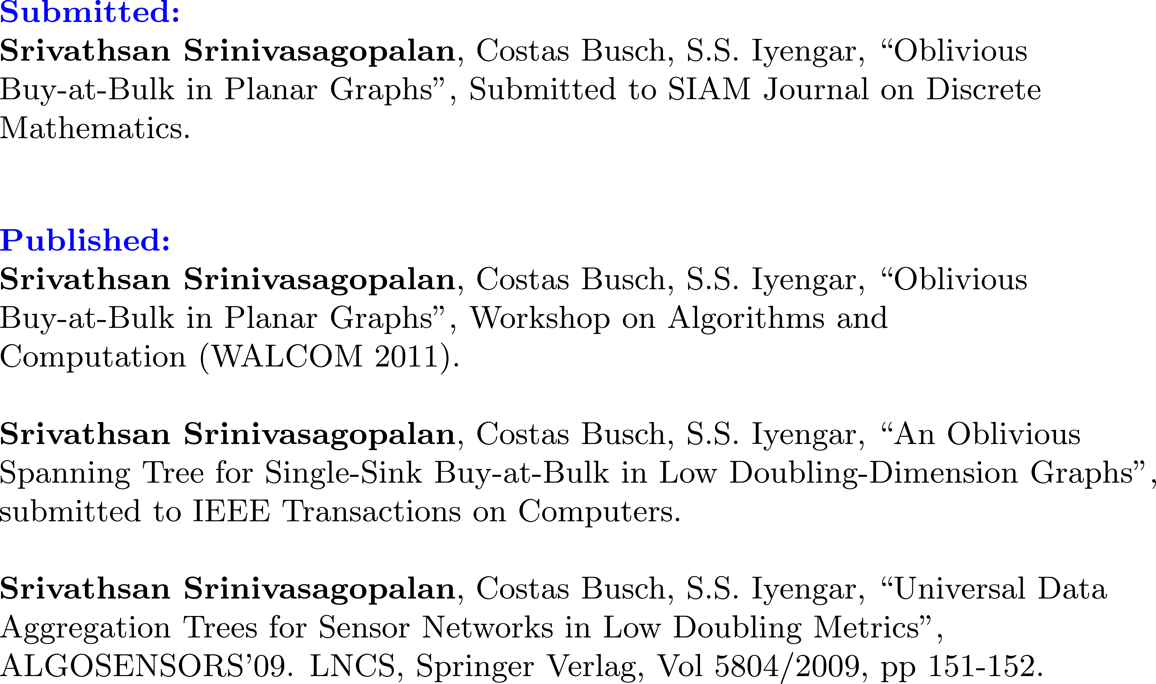

Slide 20

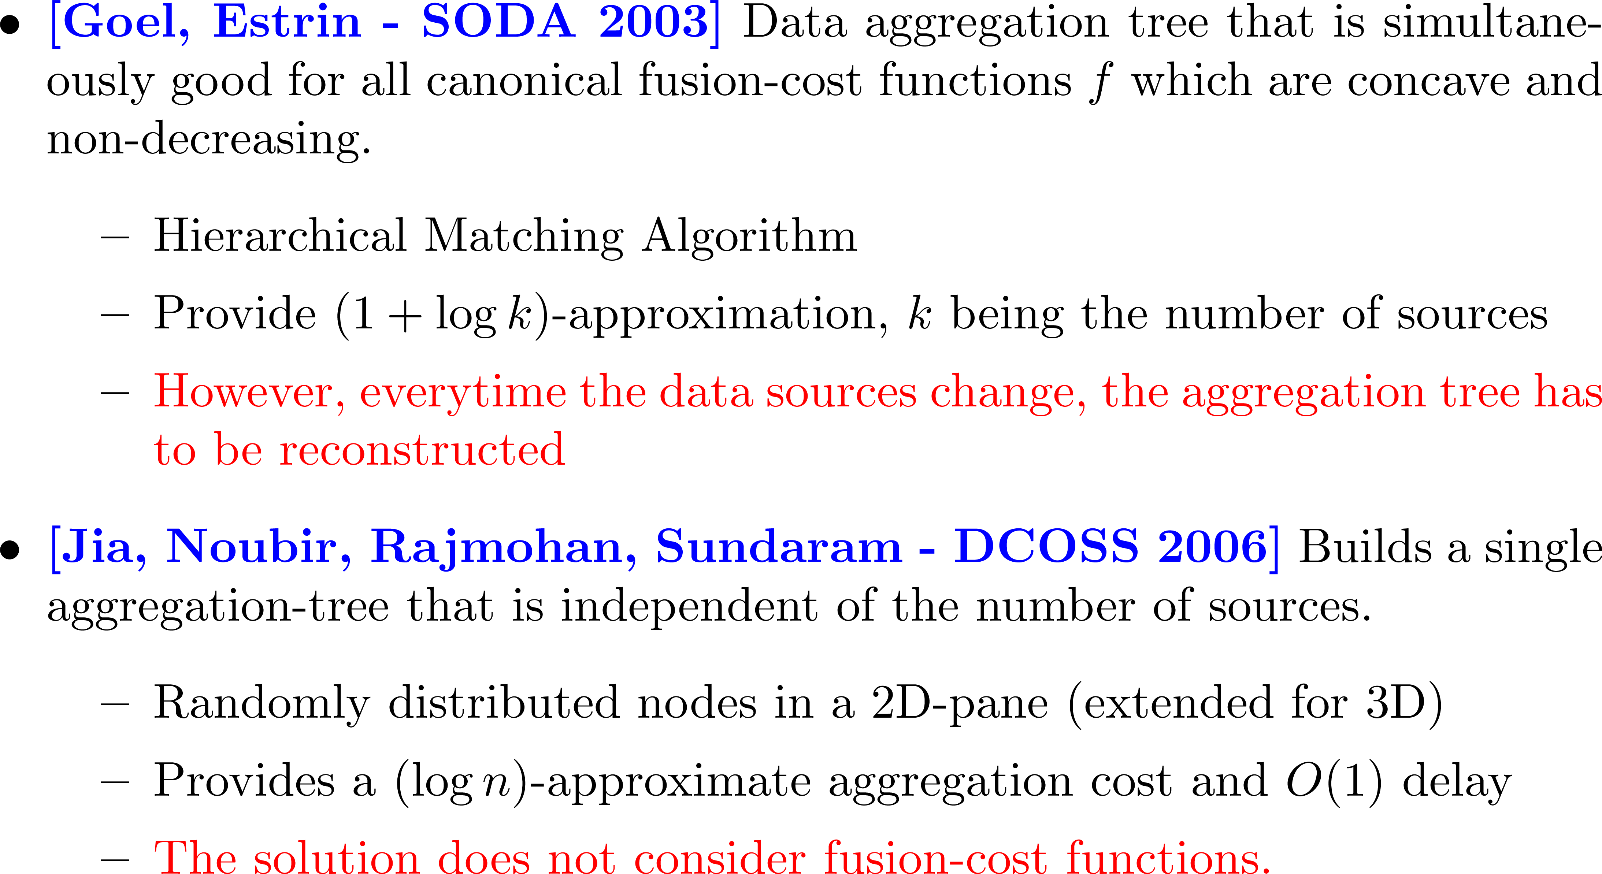

Slide 21
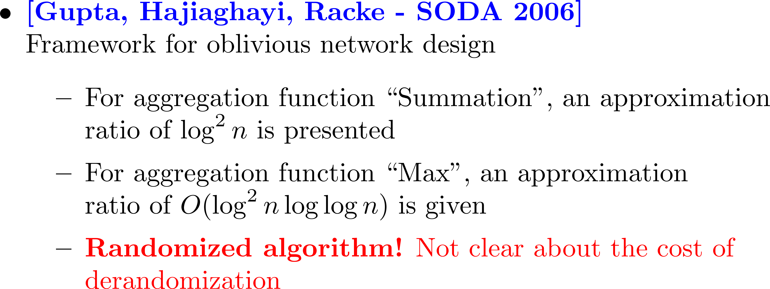

Slide 23

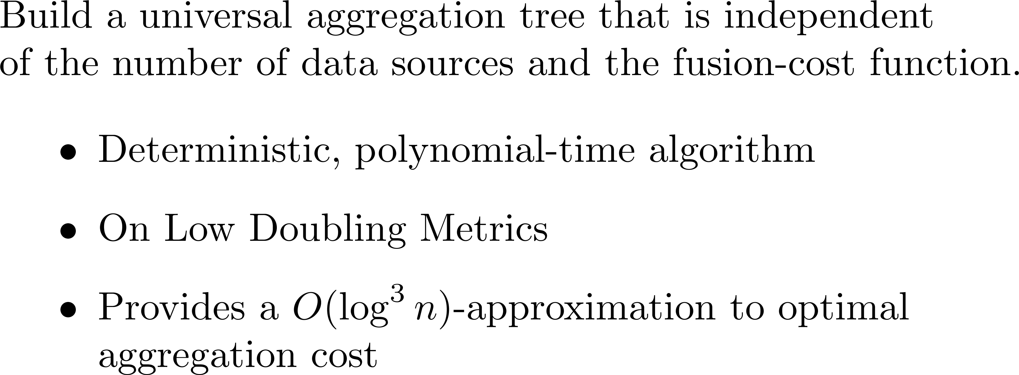

Slide 24



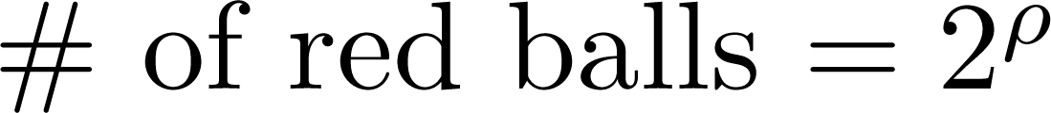

Slide 25
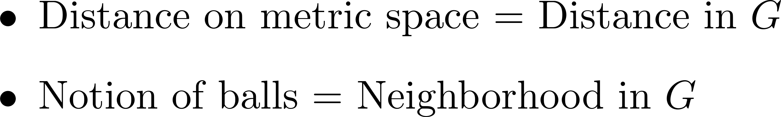

Slide 26
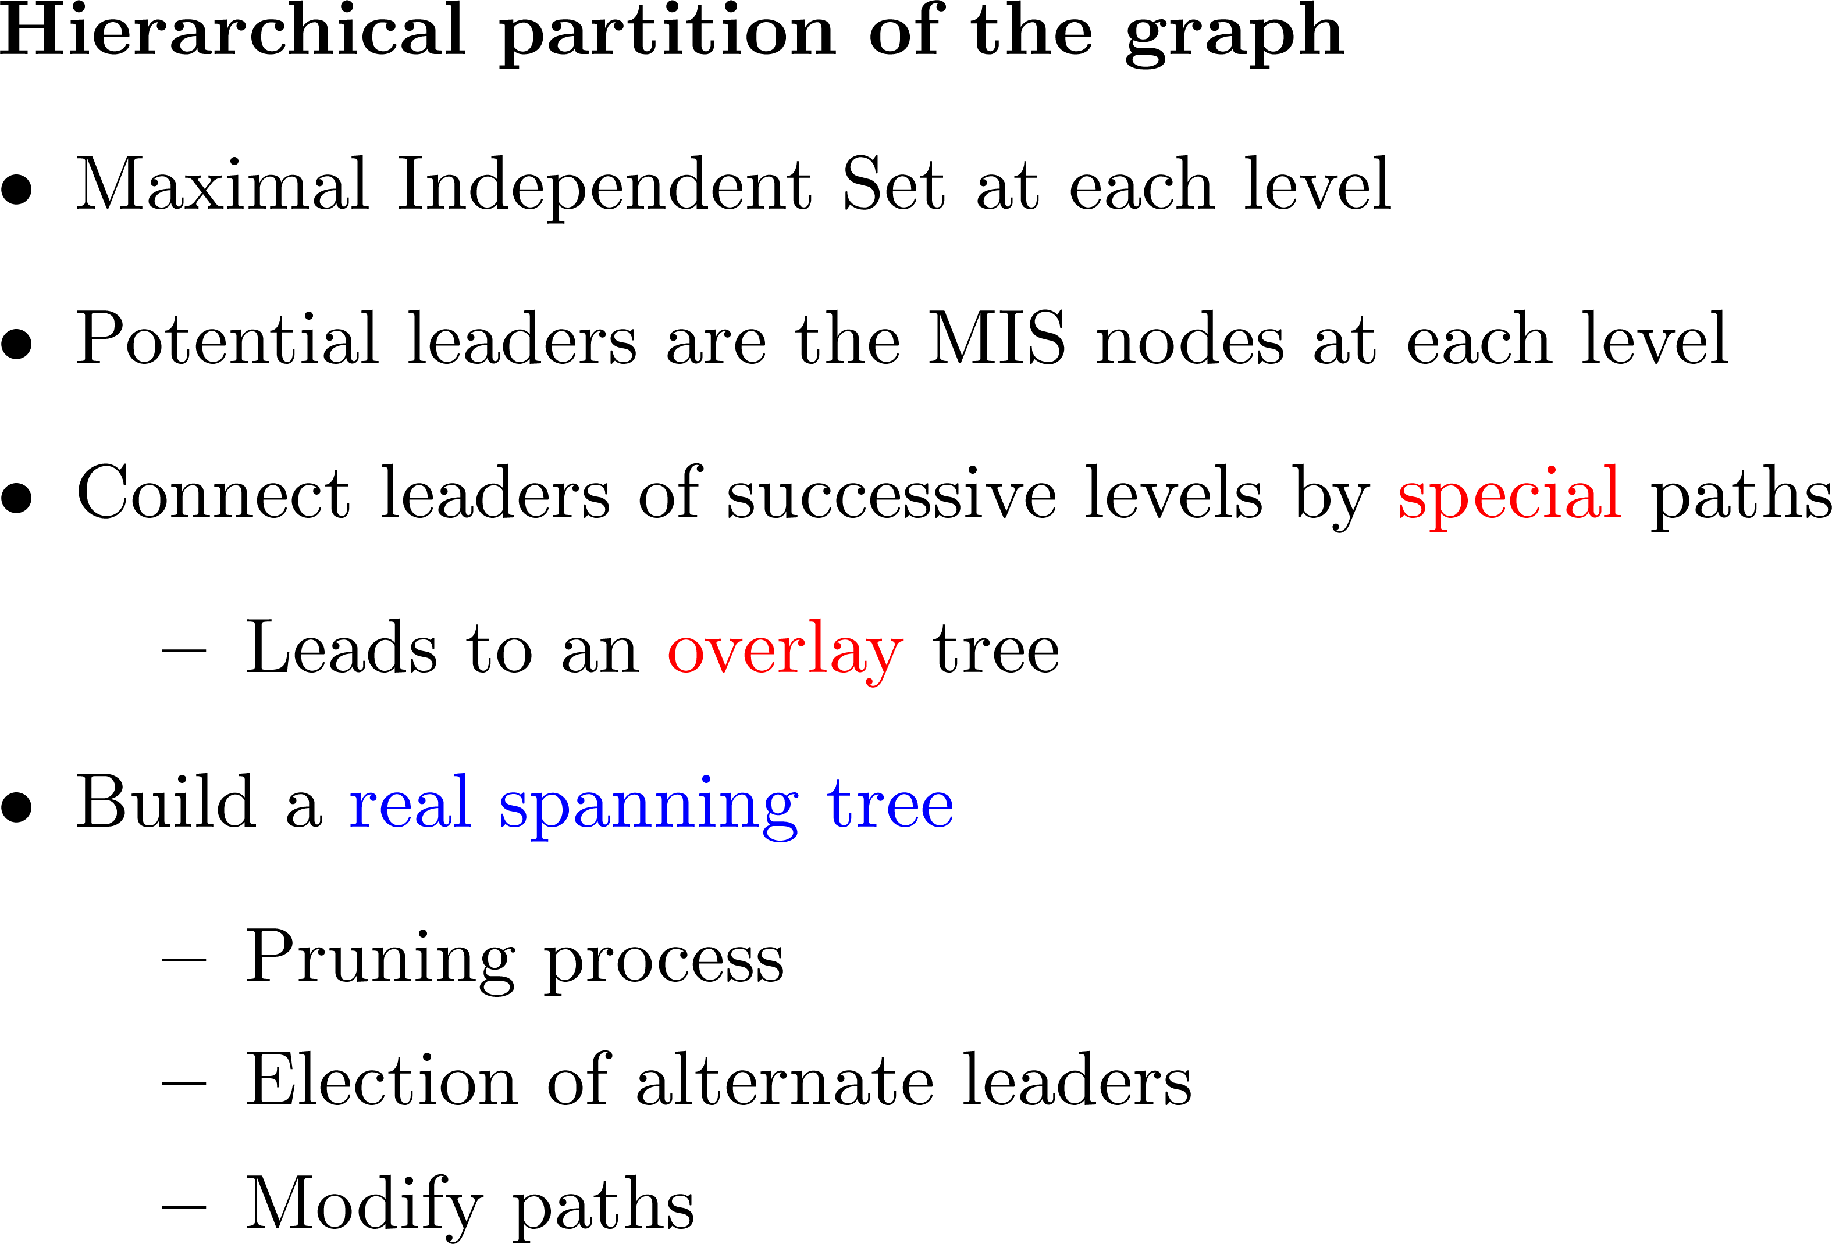

Slide 27



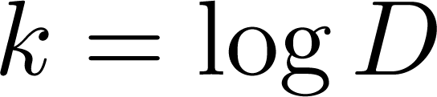
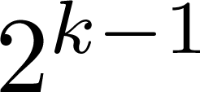

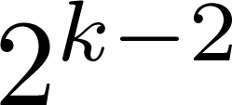

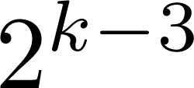


…
…………….

Slide 28
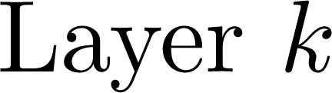


Slide 29
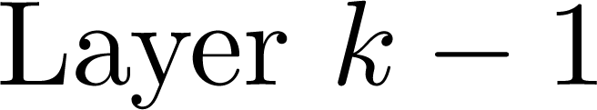

Slide 31
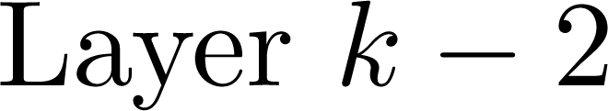

Slide 33
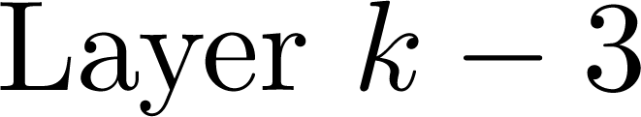

Slide 34

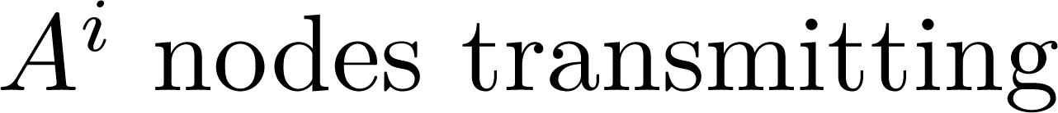
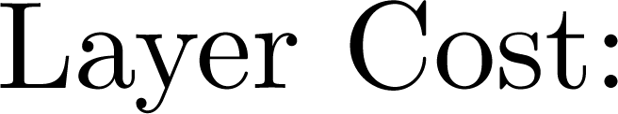
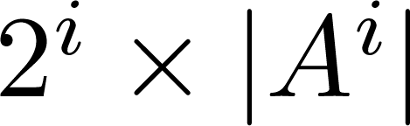
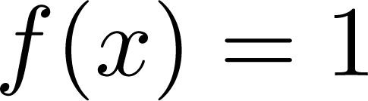

Slide 35


Slide 37
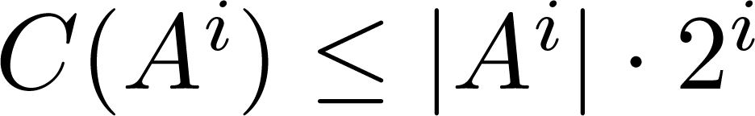
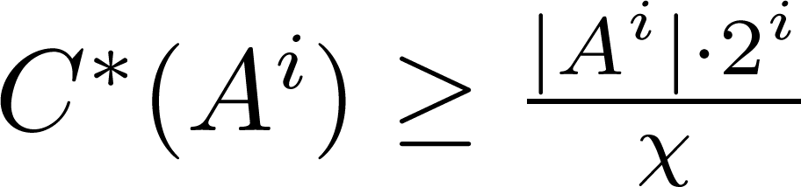

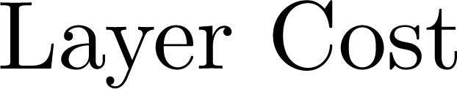


Slide 38
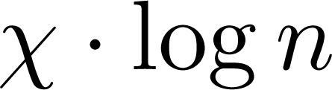

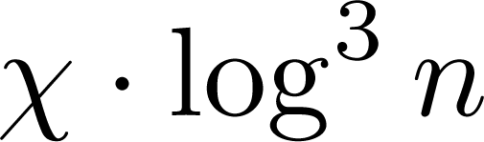

Slide 39

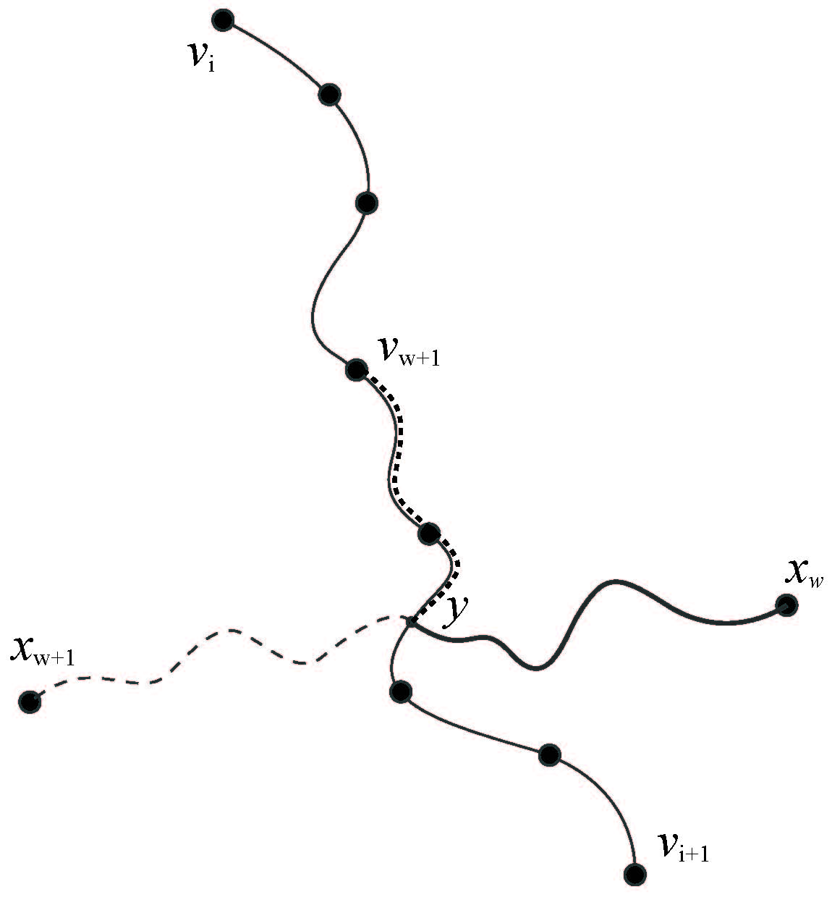
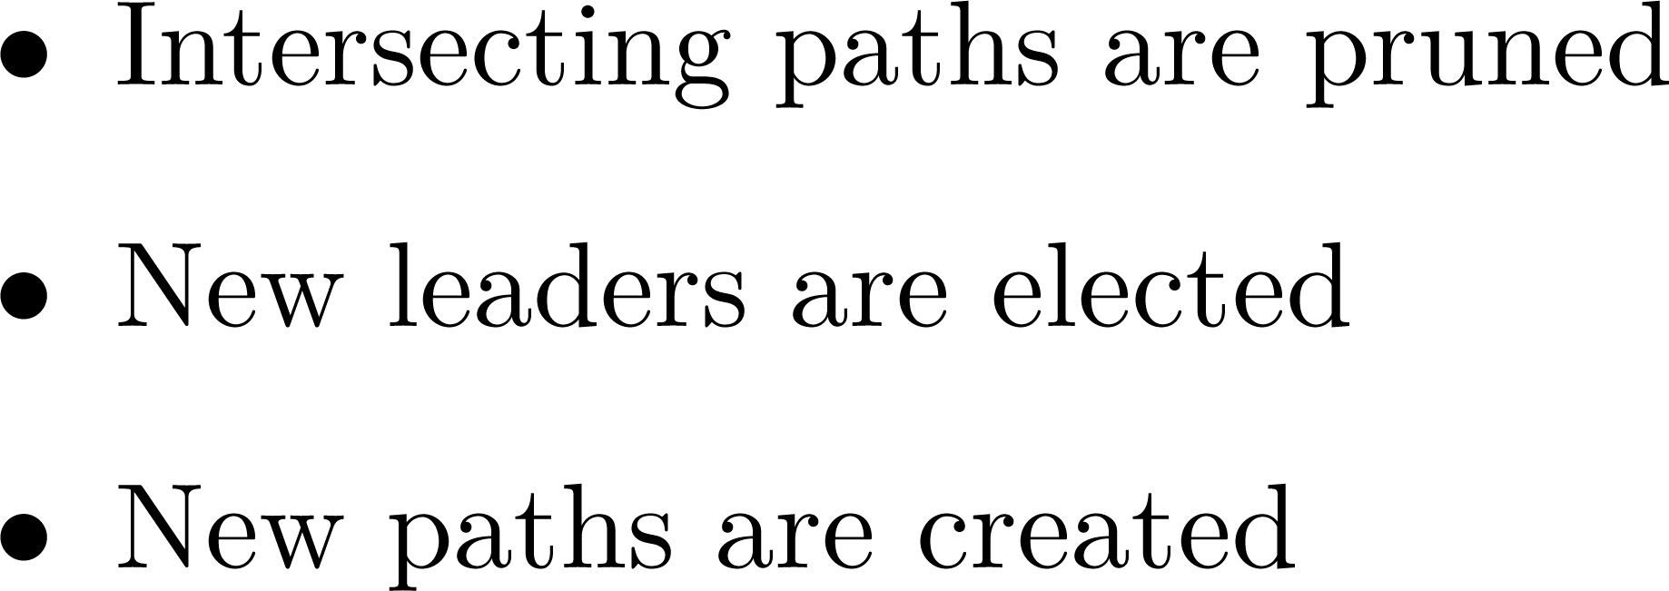



Slide 40

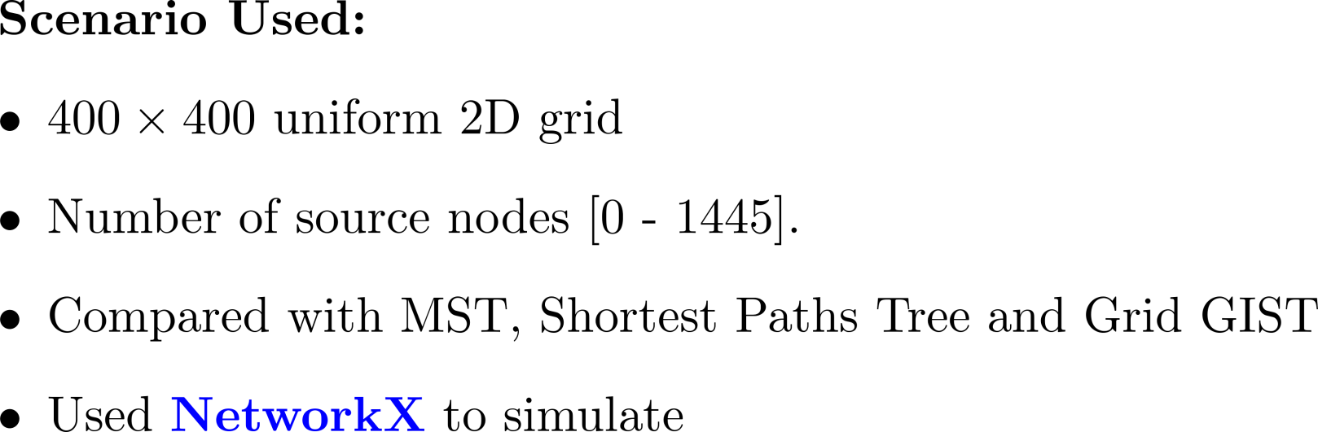

Slide 41
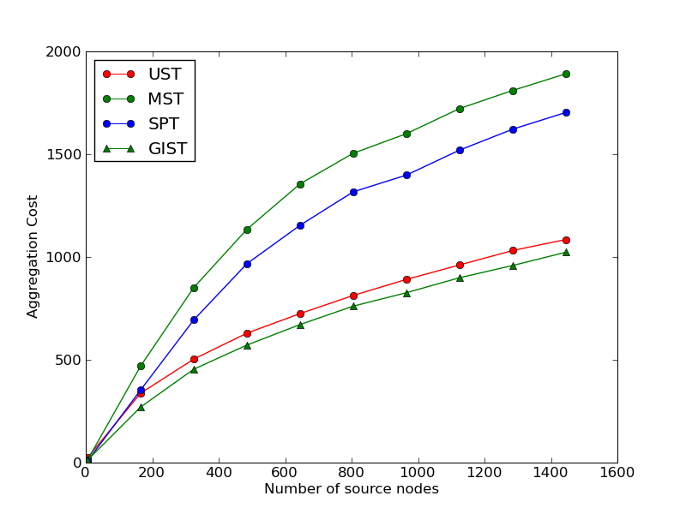

Slide 42
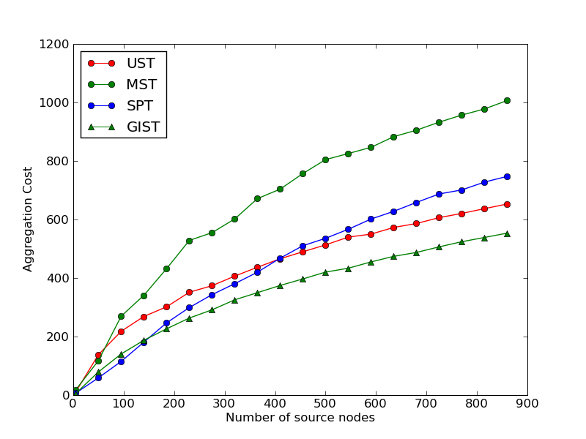

Slide 43

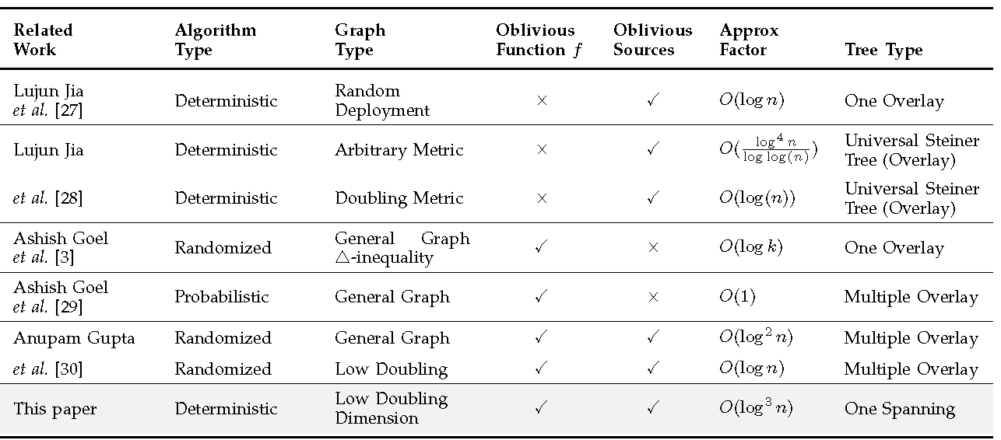

Slide 44


Slide 45
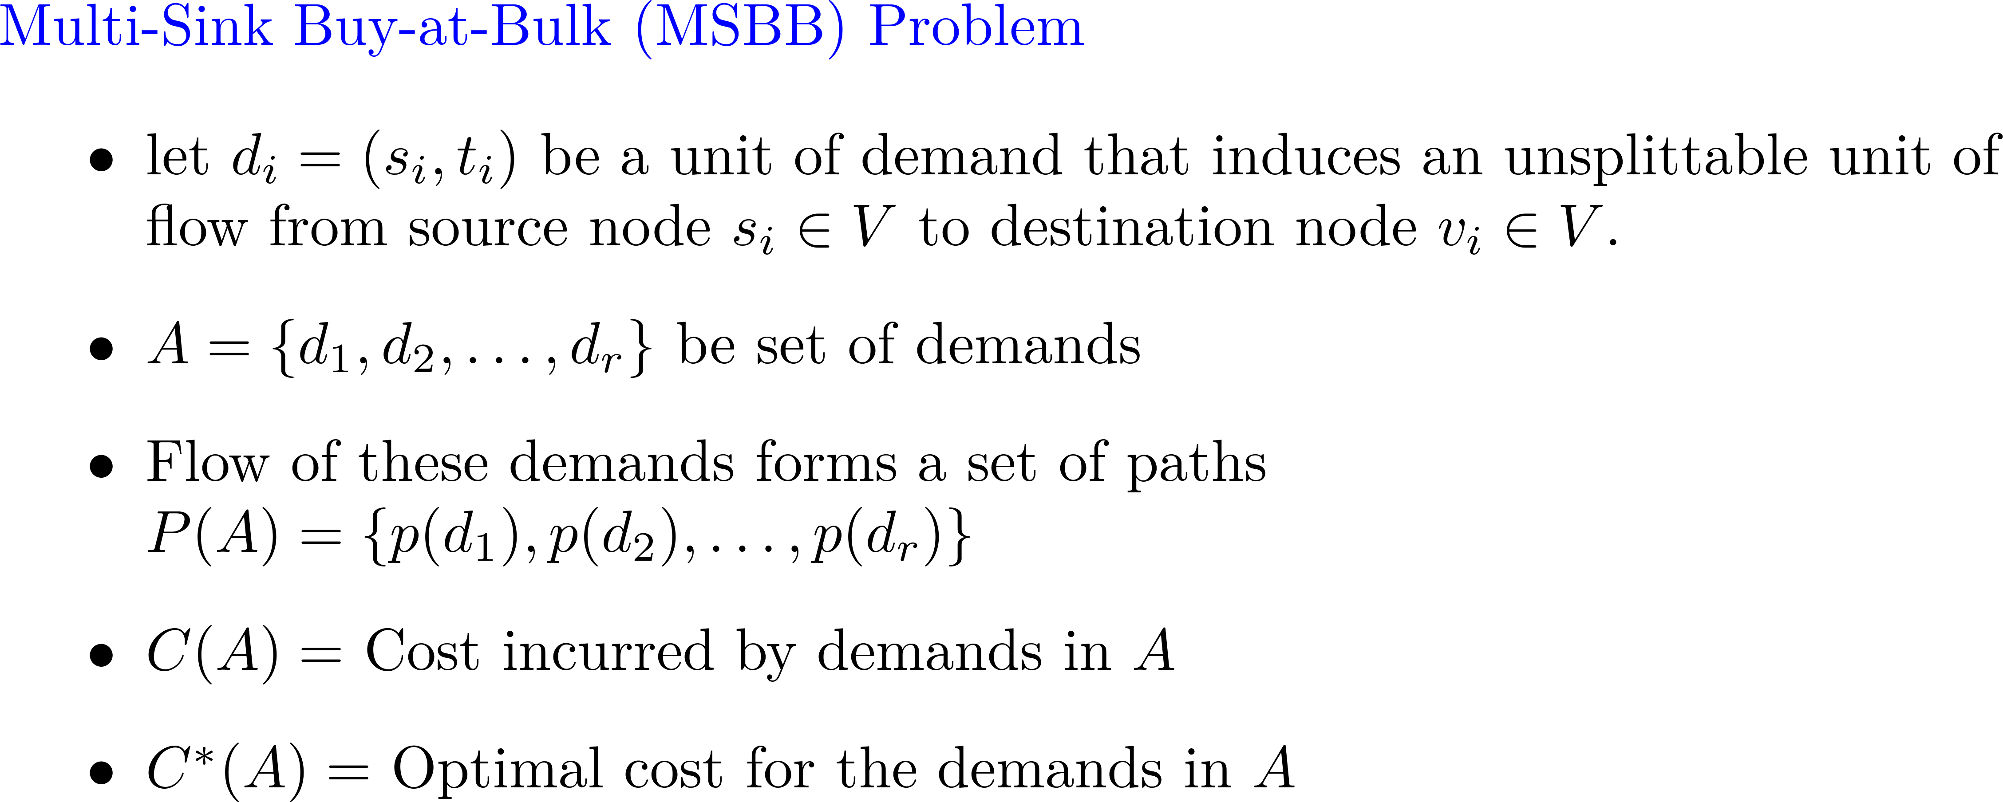

Slide 46
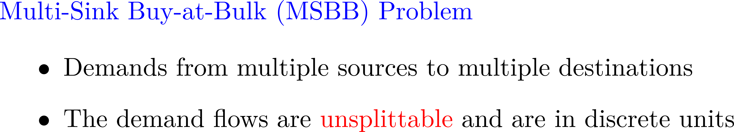


Slide 47


Slide 49


Slide 50


Slide 51



Slide 52


Slide 53







Slide 54









Slide 55


Slide 62


Slide 63


Slide 64


Slide 65

t
S

Slide 66







Slide 67



Slide 68


Slide 70


Slide 71


Slide 72



Slide 73


Slide 74


Slide 75



Slide 76


Slide 77
Laminar Sets

Slide 78



Slide 79
Merging of adjacent clusters

Slide 80
Coloring of adjacent clusters

Slide 82


Slide 83


Slide 84



Slide 87


Slide 88


Slide 89



Slide 90




Slide 91


Slide 92



Slide 93



Slide 94


Slide 95


Slide 96
Step 1: Take a shortest path (initially a single node)
Step 2: 4k-satisfy it
Step 3: Remove the 2k-neighborhood
2k
4k

Slide 97
Continue recursively…

Slide 98
4k-satisfy the path
Remove the 2k-neighborhood
Discard A, and continue
2k
2k
A
4k

Slide 99
And so on …
…

Slide 100
Analysis
All nodes are satisfied because all external nodes are 2k-satisfied
Shortest-Path Cluster was always called with 4k, so clearly the radius is O(k)
Nodes are removed upon first or second clustering, so degree ≤ 6

Slide 101
If depth(G) > k
Satisfy one zone S_{i} = G(W_{i-1} U W_{i} U W_{i+1}) at a time
Adjust for intra-band overlaps…
W_{i-1}
W_{i}
W_{i+1}
…
…
S_{i}
Notes:
S_{i} is made with the only intention of satisfying W_{i}. All the nodes to do so are in S_{i}. Because all other nodes are removed, we only have intra-band overlaps (3, no more).

Slide 102
Final Analysis
We can now cluster an entire planar graph
Radius increased due to the depth of the zones, but is still O(k)
Overlaps between bands increase the degree by a factor of 3, degree ≤ 18

